Slide 1


Using Your TELL Data:
A Guide for School Leaders
Insert date here

Slide 2
Welcome
Insert your own welcome statement here

Slide 3
Training Objectives
Become familiar with your school’s data from the 2017 survey results and the website
Understand the drill down process in order to analyze the data
Be able to unpack, disseminate and discuss teaching conditions data to create action items for school improvement

Slide 4
Agenda
Connecting to the Data
Setting the Context
Drilling Down into the Data
  Understanding the Constructs
  Examining Items
  Analyzing and Discussing a specific Item
Creating an Action Plan

Slide 5
Norms for the Discussion
Equity of Voice
Active Listening
Safety to Share Different Perspectives
Confidentiality
Other? ____________

Slide 6
Day and Night Partners
Find a Day partner who has a very different job than you. Write their name in your Day section and be sure they write your name in their Day section
Move on and go to a new person who has a similar job or content area and write each others’ names in your Night sections
Return to your seat

Slide 7
Connector Directions
Read the rating system
Reflect upon each Teaching Condition Construct and rate them from 1 (low) – 4 (high)
Reflect and write a few notes about each Teaching Conditions Construct
Find your Day partner and share out key points for 2 minutes each

Slide 8
Connector
CONSTRUCT | # | RATIONALE
 |  | Positive Aspects | Challenging Aspects
TIME
FACILITIES AND RESOURCES
COMMUNITY SUPPORT
MANAGING STUDENT CONDUCT
TEACHER LEADERSHIP
SCHOOL LEADERSHIP
PROFESSIONAL DEVELOPMENT
INSTRUCTIONAL PRACTICES AND SUPPORT

Slide 9
Setting the Context
CUSTOMIZE FOR YOUR PRESENTATION
Rationale for taking the survey
Information about the Survey

Slide 10
What We Know about
Teaching Conditions
It matters for kids
It matters for teacher retention
Principals and teachers view teaching conditions differently

Slide 11
Reform is a Long Term Process
According to new research by Linda Darling-Hammond, it takes 30 – 100 hours of professional development extended over a 6 – 12 month period to affect change in the classroom

Slide 12
Uses of the Data
As a baseline for improvement
As a metric (a way to measure) for improvement
As a way to help us prioritize our needs to inform our school improvement plan

Slide 13
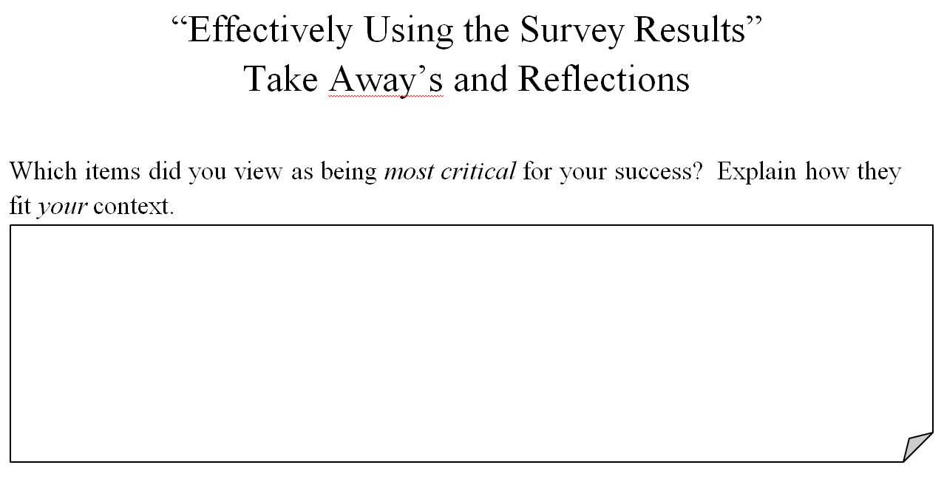
“Using the Survey Results Effectively” Article
Read the article, taking notes on the Reflection work sheet
Respond to the prompts on the Reflection worksheet
Group Debrief

Slide 14
Data Drill Down Process
Examine the Construct Indicators
Examine Items Within the Construct
Determine an Item of Focus
Determine a Construct of Focus
Develop Plan
Analyze Individual Items

Slide 15
Basic TELL Vocabulary
TELL – Teaching, Empowering , Leading and Learning
Teaching Conditions – the systems, relationships, resources, environments and people in your school that affect your ability to teach (or learn) at a high level
Construct – a grouping of several specific questions, all dealing with the same topic
  Time, Facilities and Resources, Community Support and Involvement, Managing Student Conduct, Teacher Leadership, School Leadership, Professional Development, and Instructional Practices and Support
Item – a specific individual question

Slide 16

http://tellkentucky.org

Slide 17
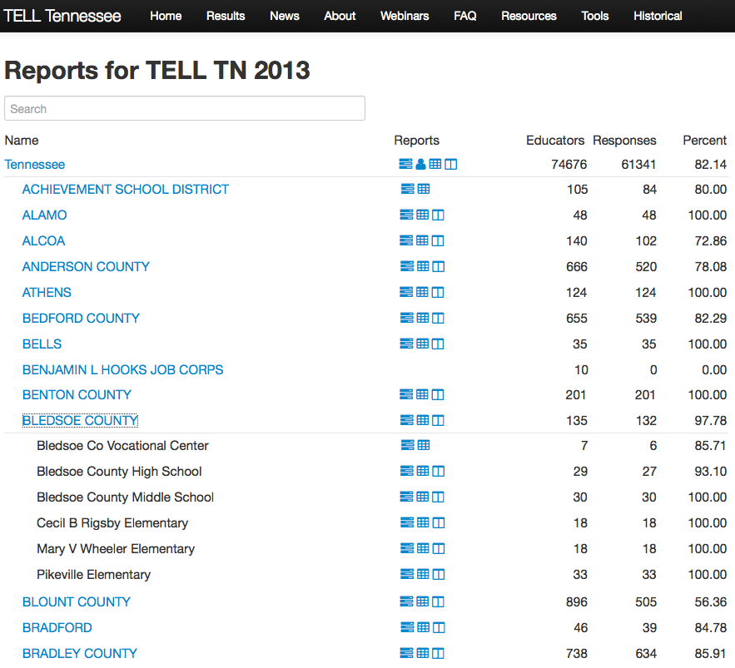
Find your District and School
Example Screenshot

Slide 18
What Do the Numbers Mean?
Example Screenshot

Slide 19
Impact of % Completing the Survey
Within schools in your district, there is a wide range of percentage of educators who completed the survey
With an elbow partner, reflect upon what those varieties of percentages can mean for your school?
Why are the percentages important to know?

Slide 20
Access to the Detailed Results
Example Screenshot

Slide 21
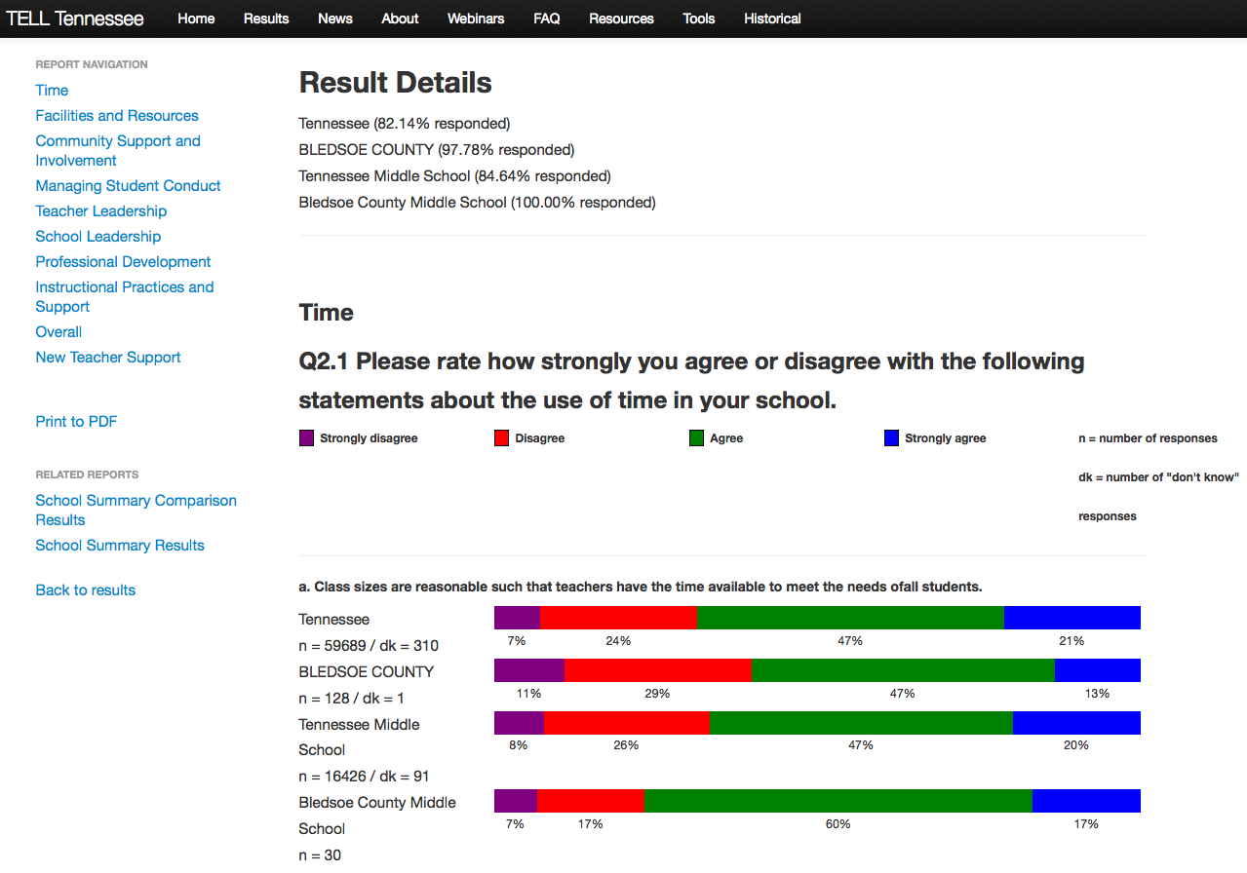
Detailed Results
Example Screenshot

Slide 22
Access to the Summary Results
Example Screenshot

Slide 23
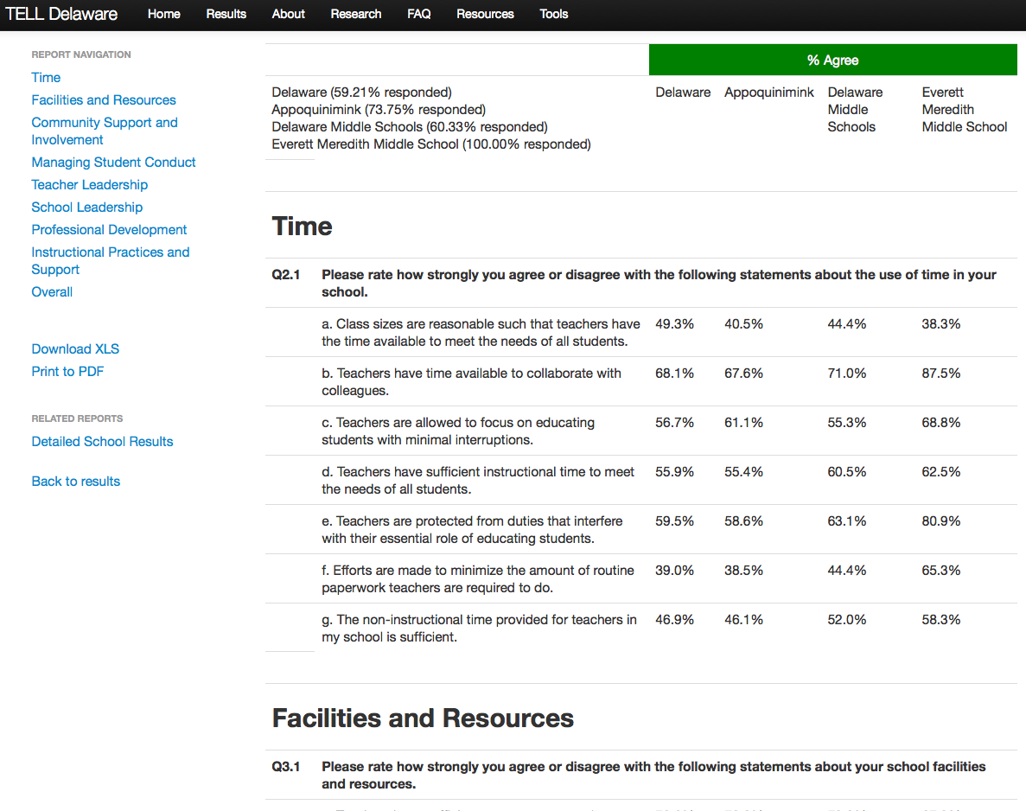
Summary Results
Example Screenshot

Slide 24
Access to the Comparison Results
Example Screenshot

Slide 25
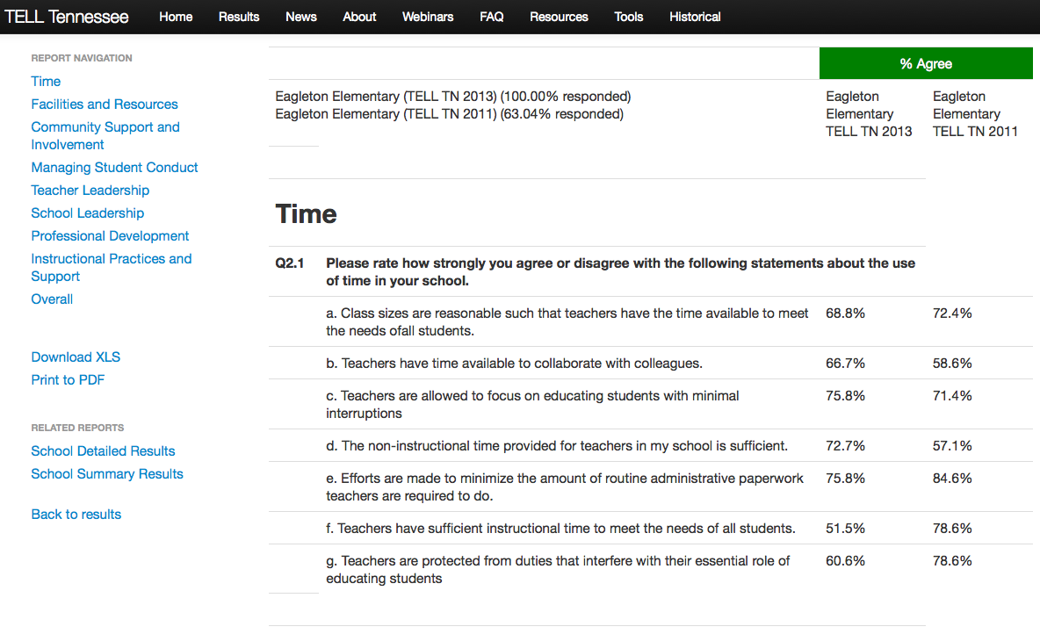
Comparison Report
Example Screenshot

Slide 26
BREAK TIME !
Place this wherever needed.

Slide 27
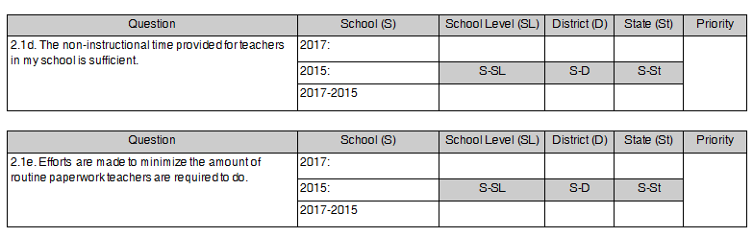
Construct Indicator Worksheet

Slide 28
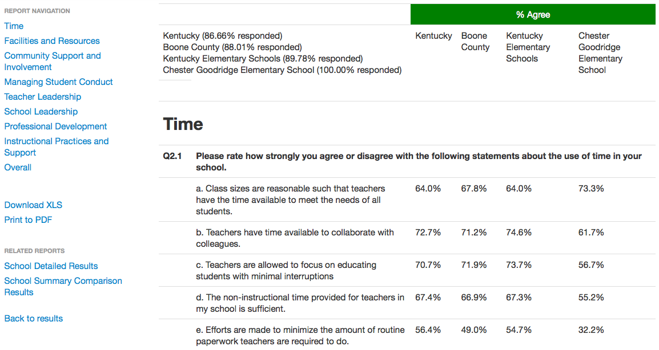
Summary Report – Finding Your School Data
State
District
Level
School
State District Level School

Slide 29
Construct Indicator Worksheet
Marking Your School Data
55.2

Slide 30
Summary Report – Finding Your School Level Data
State
District
Level
School
State District Level School

Slide 31
Construct Indicator Worksheet
Marking Your School Level Data
55.2
67.3

Slide 32
Summary Report – Finding Your District Data
State
District
Level
School
State District Level School

Slide 33
Construct Indicator Worksheet
Marking Your District Data
55.2
67.3
66.9

Slide 34
Summary Report – Finding Your State Data
State
District
Level
School
State District Level School

Slide 35
Construct Indicator Worksheet
Marking Your State Data
55.2
67.3
66.9
67.4

Slide 36
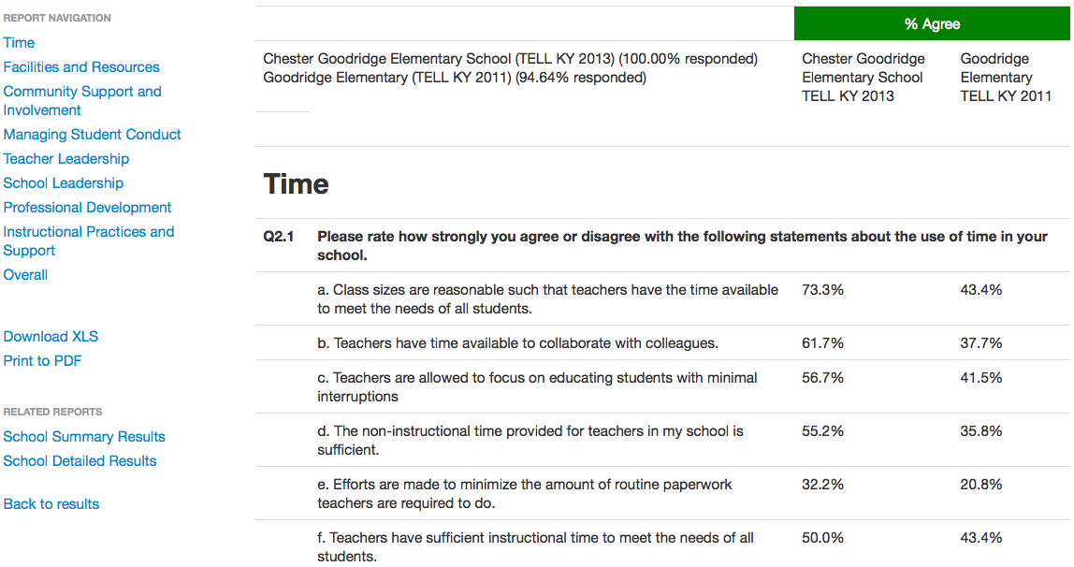
Summary Results Comparison Report – Results from 2015
School Name
School
2017
School
2015

Slide 37
Construct Indicator Worksheet
Marking Your Data From 2015
55.2
67.3
66.9
67.4
35.8

Slide 38
Construct Indicator Worksheet
Calculate Growth from 2017 to 2015
55.2
67.3
66.9
67.4
35.8
19.4

Slide 39
Compare Your School Data to the School Level Data
55.2
67.3
66.9
67.4
35.8
19.4
-12.1

Slide 40
Compare Your School Data to the District Data
55.2
67.3
66.9
67.4
35.8
19.4
-12.1
-11.7

Slide 41
Compare Your School Data to the State Data
55.2
67.3
66.9
67.4
35.8
19.4
-12.1
-11.7
-12.2

Slide 42
Prioritize the Constructs
Prioritize the Constructs on your own
  “1” = highest priority; “8” = lowest priority
Compare your list with your table group
Together decide upon a common list
Record your greatest STRENGTH on a yellow post-it note
Record your greatest NEED on a blue post-it note

Slide 43
Prioritize the Constructs
55.2
67.3
66.9
67.4
2
35.8
19.4
-12.1
-11.7
-12.2
xx.x
xx.x
xx.x
xx.x
xx.x
6
xx.x
xx.x
xx.x
xx.x

Slide 44
Construct a Consensogram
Have 1 person at your table place your yellow STRENGTH post-it above the appropriate construct on the poster
Place your blue NEED post-it above its construct as well
If there is already a post-it at the bottom of the chart, place your post-it above that one to make a bar chart

Slide 45
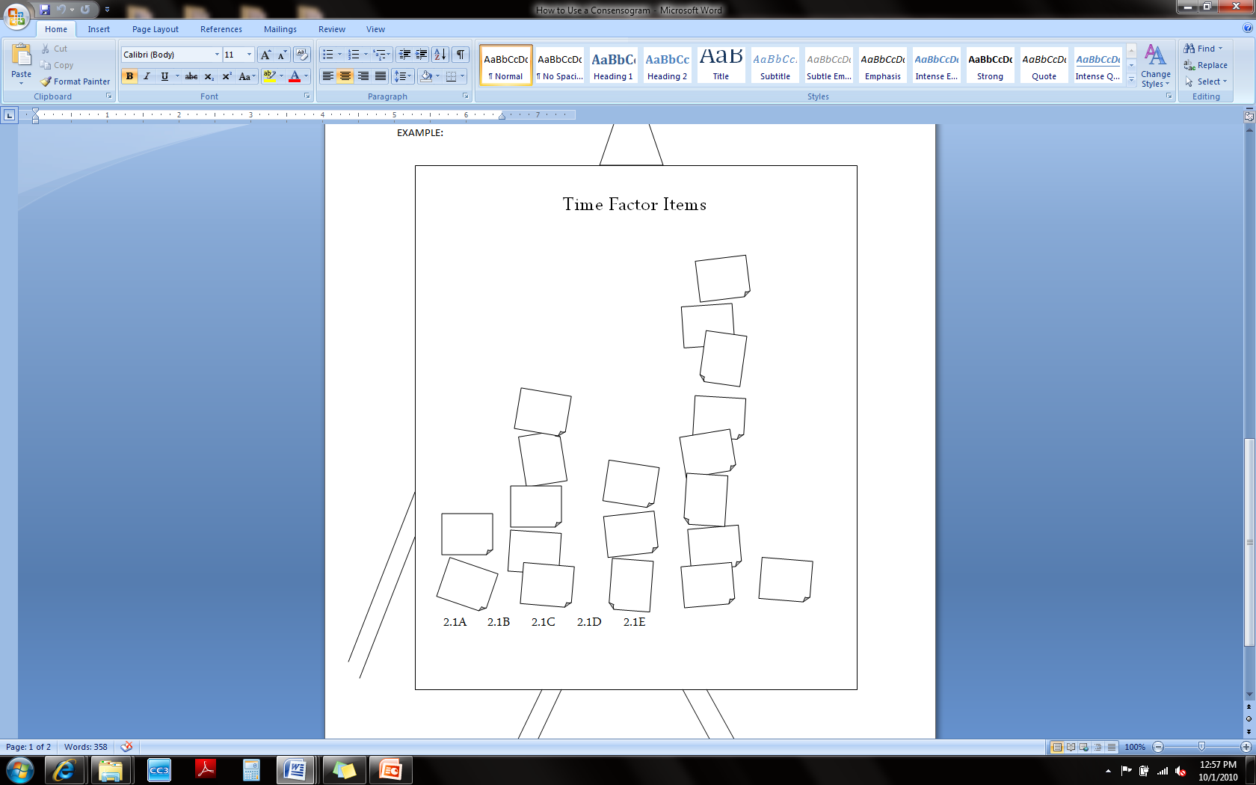
Consensogram
2.1A 2.1B 2.1C 2.1D 2.1E

Slide 46
Consensogram Findings
Examine the consensogram findings
Are there any patterns?
Which Constructs stand out?
Which Constructs are sparsely posted?
What does this tell us about how we perceive our school’s teaching conditions?

Slide 47

It’s How You See Things

Slide 48
Range of % Agreement
State
District
Level
School
State District Level School

Slide 49
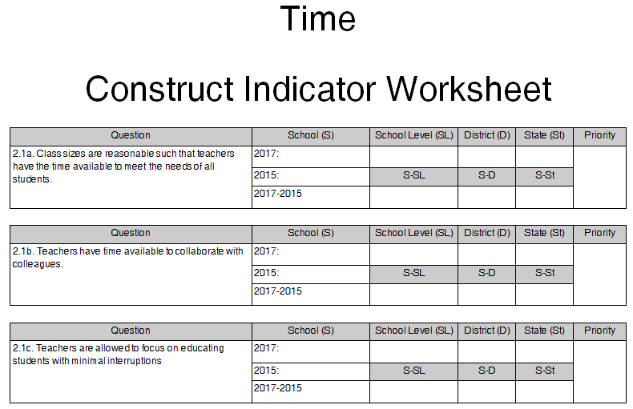
Construct Item Work Sheet

Slide 50
Choose an Item of interest
Narrow your focus even further by prioritizing your Items for this Construct
  Your item of focus does NOT have to be your lowest item score
  You and your faculty know the context of your school. Use that knowledge to choose an item of greatest impact to explore further

Slide 51
Item Consensogram
Have 1 person at your table place your yellow 1st choice post-it above the appropriate Item letter on the poster
Place your blue 2nd choice post-it above its item letter as well
If there is already a post-it at the bottom of the chart, place your post-it above that one to make a bar chart

Slide 52
Item Consensogram Findings
Examine the Consensogram findings
Are there any patterns?
Which Items are most populated?
Which Items can we rule out?
What does this tell us about our current needs?

Slide 53
Detailed Report
The Detailed Report gives more specific information about how strongly people feel about the teaching condition
Notice the indicators range from Strongly Disagree, Disagree, Agree to Strongly Agree.
N = number of people who responded
DK = People who answered, “Don’t Know”

Slide 54
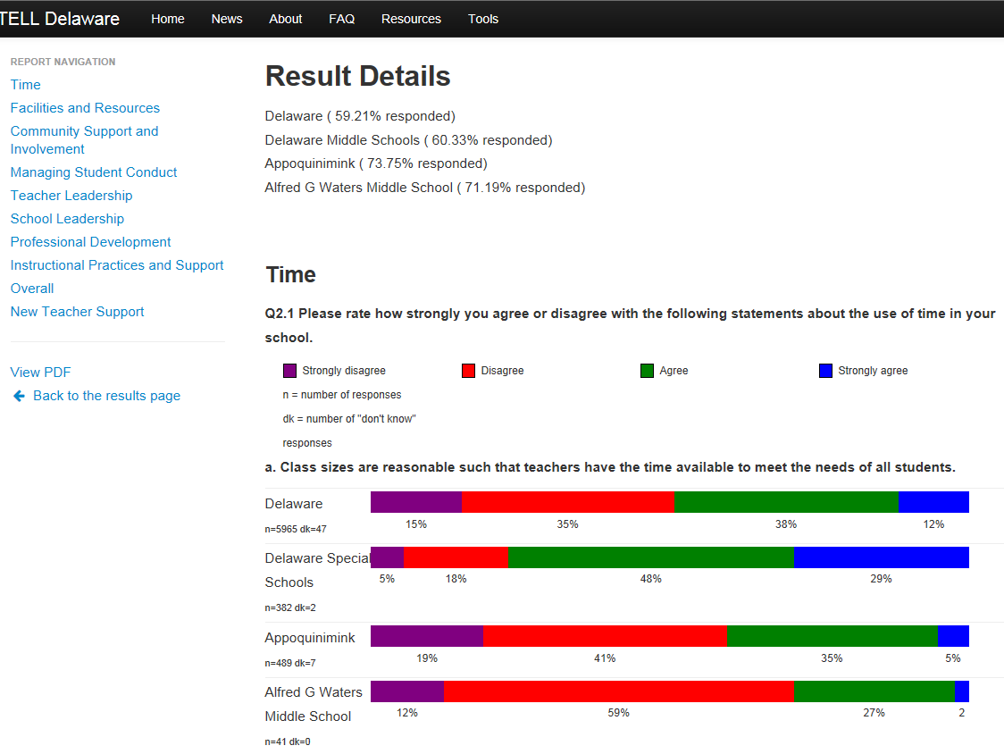
Detailed Report
State
State
District Name
School Level
School Name
State
District
School Level
School

Slide 55
Detailed Report Makes the data more Real
In the example in item 2.1A, the equation would be: 41 (N) x .12 (strongly disagree) = 4.92. So about 5 of the 41 people strongly disagreed that they have time available to collaborate with their colleagues.
Take 2 minutes now to review the Detailed Report data for our question
What conclusions can your draw about our teaching conditions from this additional information?

Slide 56
What about N ?
Does N match the number of teachers at your school?
What if N = 41, but there are 80 teachers at your school?
What does that indicate?

Slide 57
Two Methods for Examining Individual Items
A linear process for Analyzing an Item
Individual Item Prompts for guiding reflective conversations

Slide 58
Process for Analyzing an
Identified Item
What is working?
What is not working?
What would be ideal?
What are challenges to achieving the ideal?

Slide 59
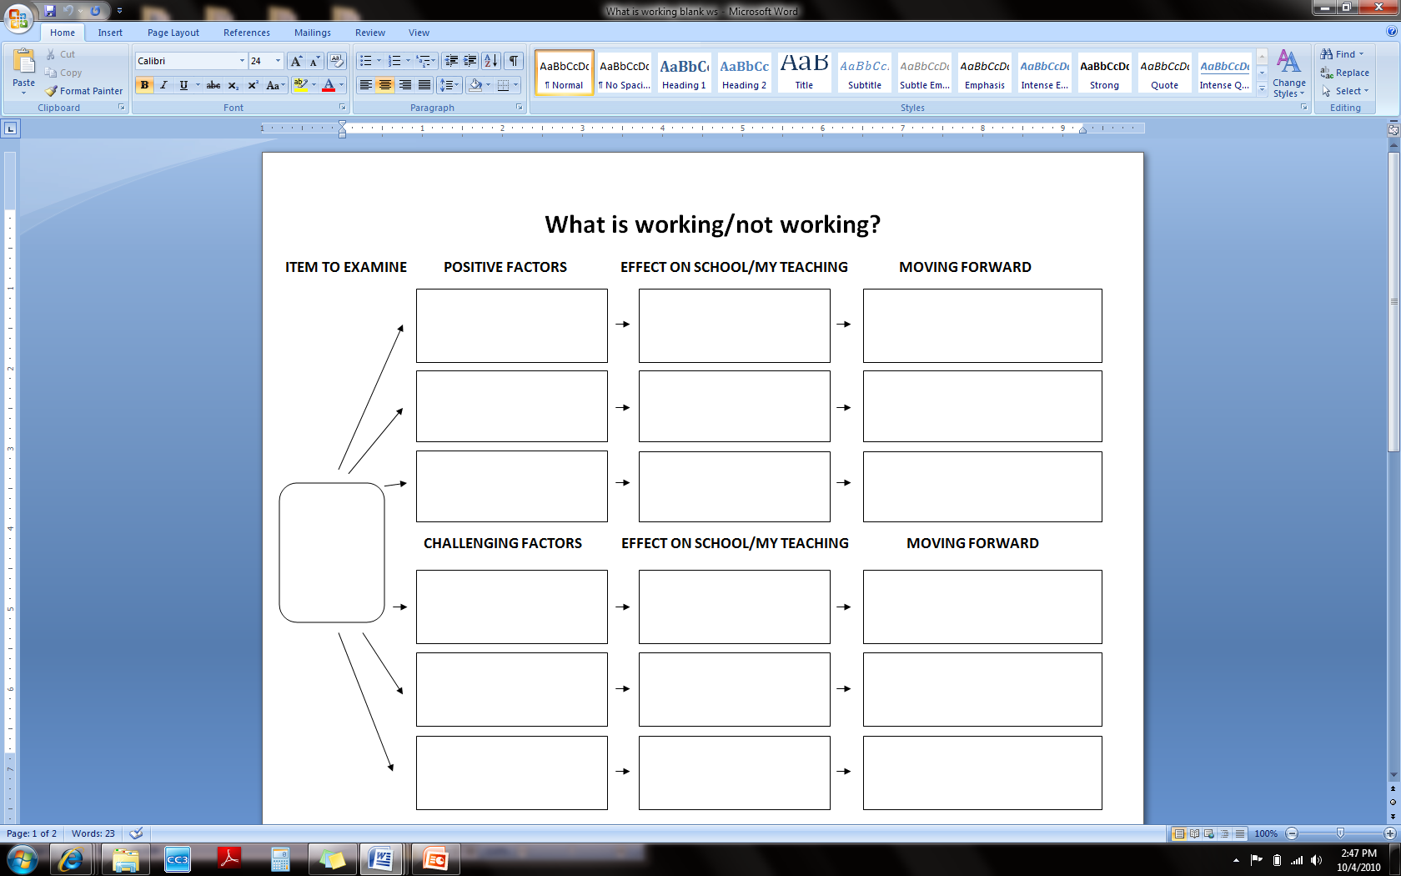
Fill in your own “What’s Working”

Slide 60
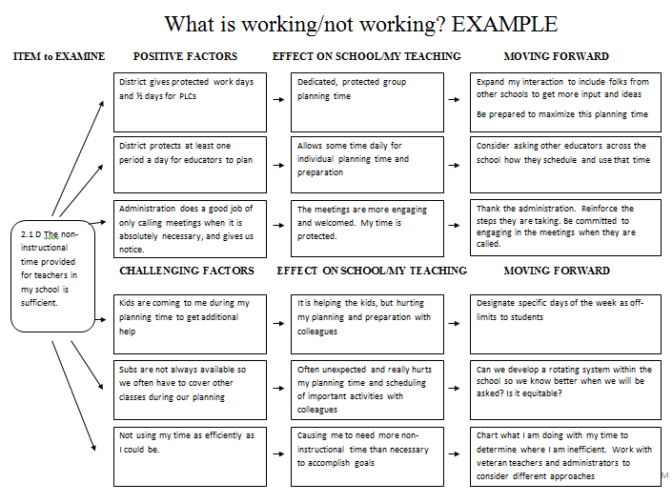
What’s Working? What’s Not?

Slide 61
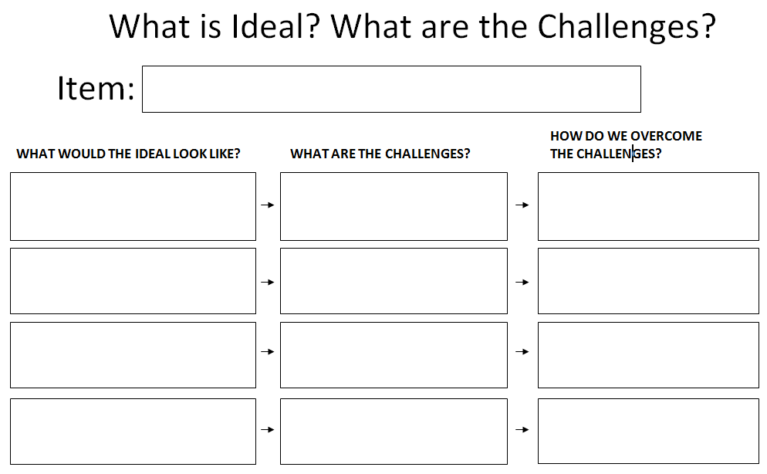
Where are we Going?

Slide 62
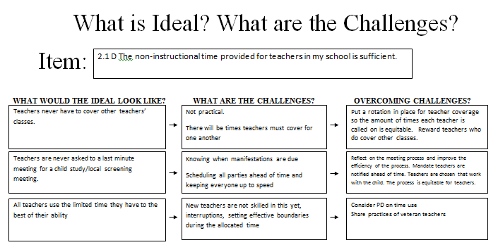
Ideal Example

Slide 63
Brainstorm Ideal Situations
Find your Night Partner
Pair up with another set of Night Partners
Brainstorm a list of Ideal situations regarding our item

Slide 64
Graffiti Wall Directions
Stand by your assigned poster
Record 3 or 4 Challenges to the Ideal
Brainstorm as many ways to overcome those challenges as possible (8 minutes)
Rotate to next station Ideal at the signal (4 minutes per station)
Return to your original poster and reflect upon ideas added by your colleagues

Slide 65
Graffiti Wall Ideals
___________________
CHALLENGE #1 | CHALLENGE # 2 | CHALLENGE # 3
Ways to Overcome | Ways to Overcome | Ways to Overcome

Slide 66
Individual Item Prompts
Are used to guide reflective, collaborative conversations about specific school conditions
Are a series of reflective prompts for nearly every question in the survey and are available on-line
Are not the only questions to ask, but provide a starting point for dialogue

Slide 67
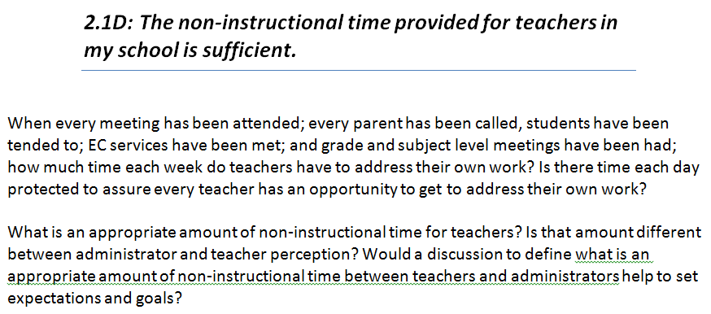
Sample Item Prompt

Slide 68
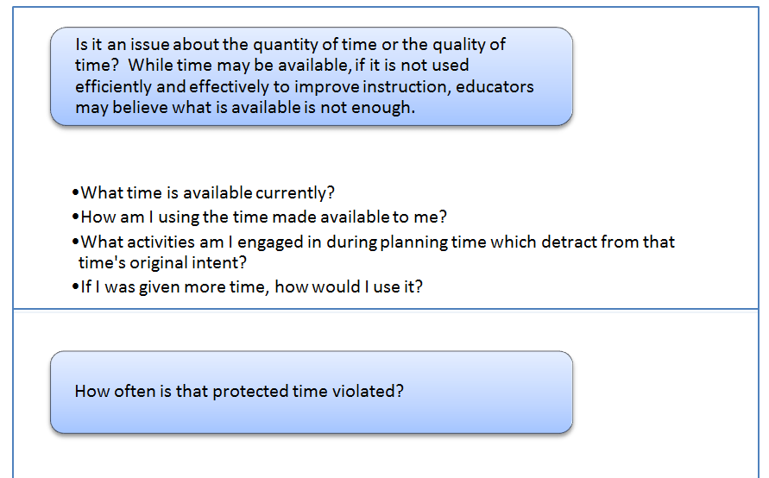
2.1D: Reflections

Slide 69
Item Prompt Discussion
Assign a Facilitator, Recorder and Reporter
Reflect upon these questions, or discuss any other questions that arise ON TOPIC
Record the group’s thoughts
Pay attention to collaborative norms
Be ready to share key points

Slide 70
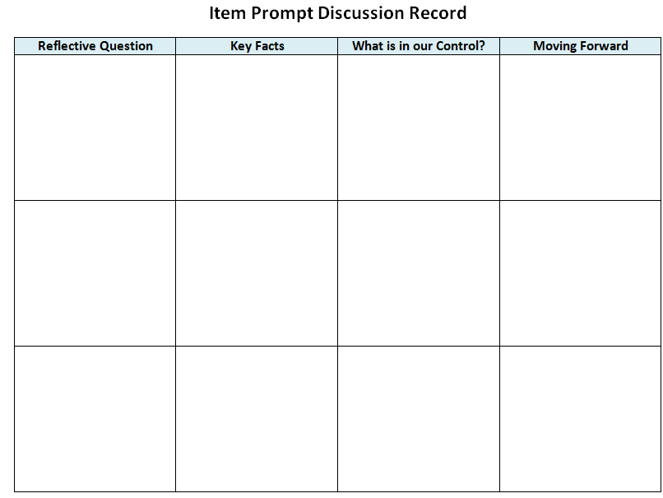

Slide 71
Creating an Action Plan

Slide 72
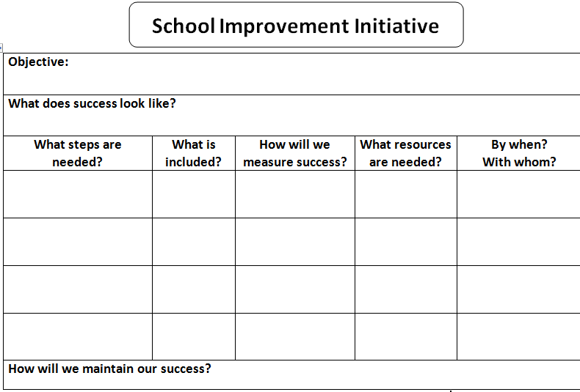

Slide 73
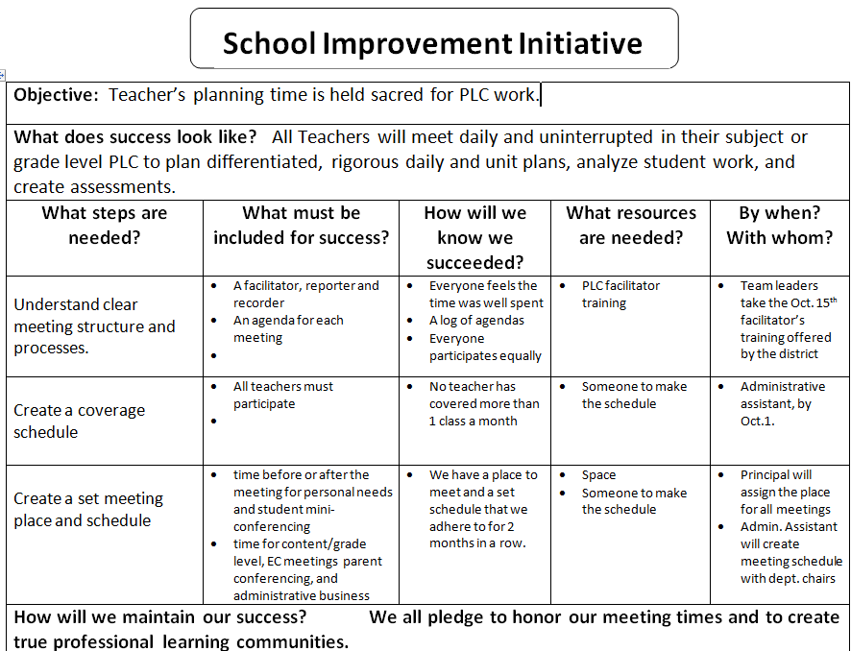

Slide 74
SMART GOALS
Specific
Measurable and Observable
Attainable
Realistic
Timely

Slide 75
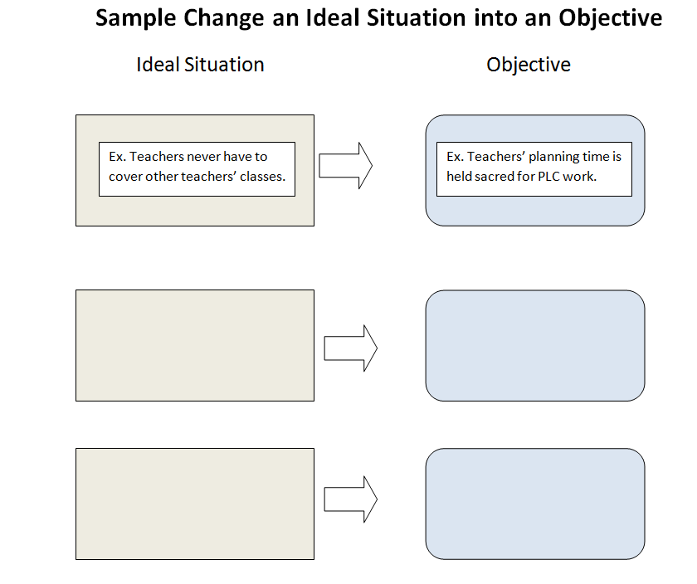

Slide 76
Creating Objectives
Come to consensus about a single objective by combining dominant ideas.
Place a Check by key nouns that are repeated - Time, Planning, Meeting
Underline key verbs/adverbs that are repeated – Meet Efficiently, Listen carefully,

Slide 77
Spell Out Success
What does your Objective look like specifically?
Turn to an elbow partner behind you, someone NOT at your table, and describe your image of success with this objective (4 minutes)

Slide 79
2 + 2 = 4 Directions
Write one step that is critical for meeting our objective in the first box.
Share that idea with another person and write their idea in the second box.
Go to another person, give her your 2 ideas and record her 2 ideas on your paper.

Slide 80
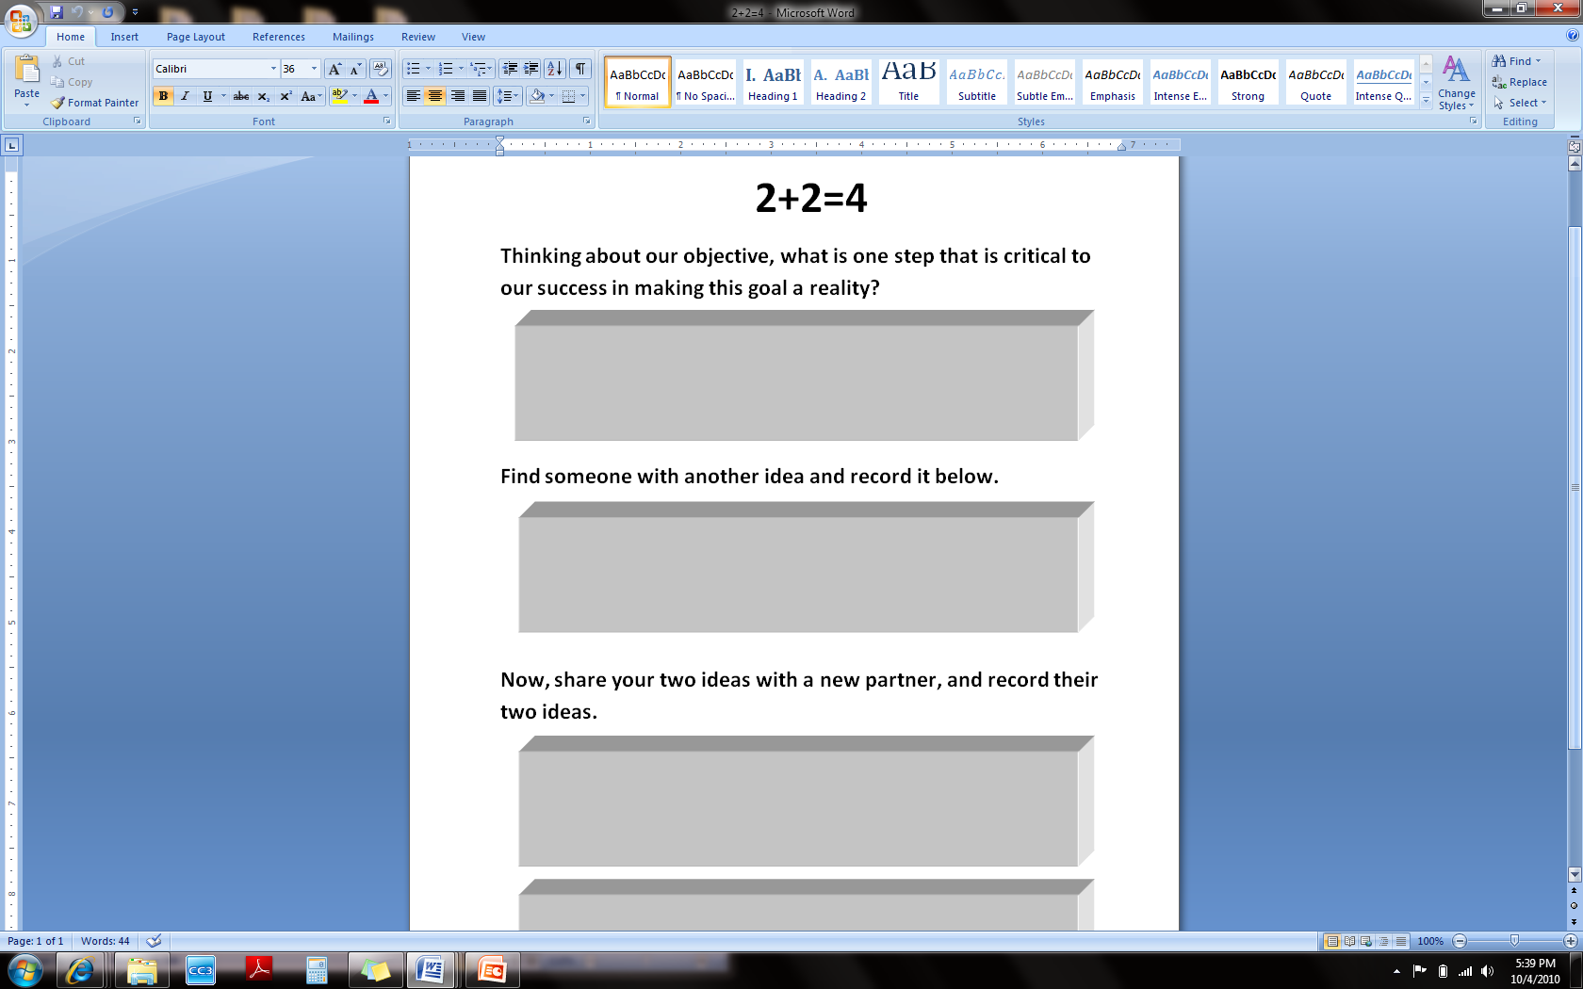

Slide 81
3 Finger Voting
Each person is allowed 3 votes.
  You can use all 3 fingers to vote for one answer you feel strongly about, or use 1 vote to count for 3 different choices.
  Or you can vote two fingers for choice #1, and one finger for choice #2, etc…
Count scores at the end to determine which Steps to use.

Slide 82
Finish the Action Plan
Fill in the assigned section of the Action Plan with your table group
  What must be included?
  How will we know we succeeded?
  What resources are needed?
  By Whom? / By When?
Report out
Commit to the goal

Slide 83
Congratulations !! We DID IT !
This is only the beginning!!
We’ve worked and identified an area for growth
We’ve made an action plan for HOW we’ll improve
Now we have to DO it

Slide 84
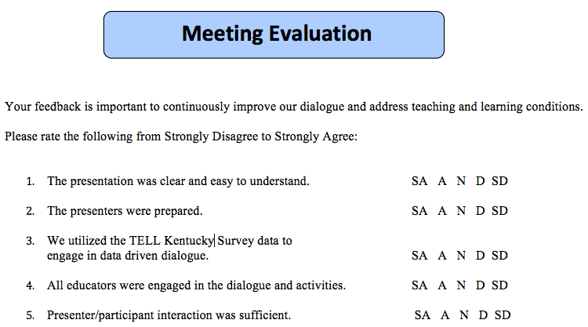
Questions and Evaluation Sheet

